Slide 1
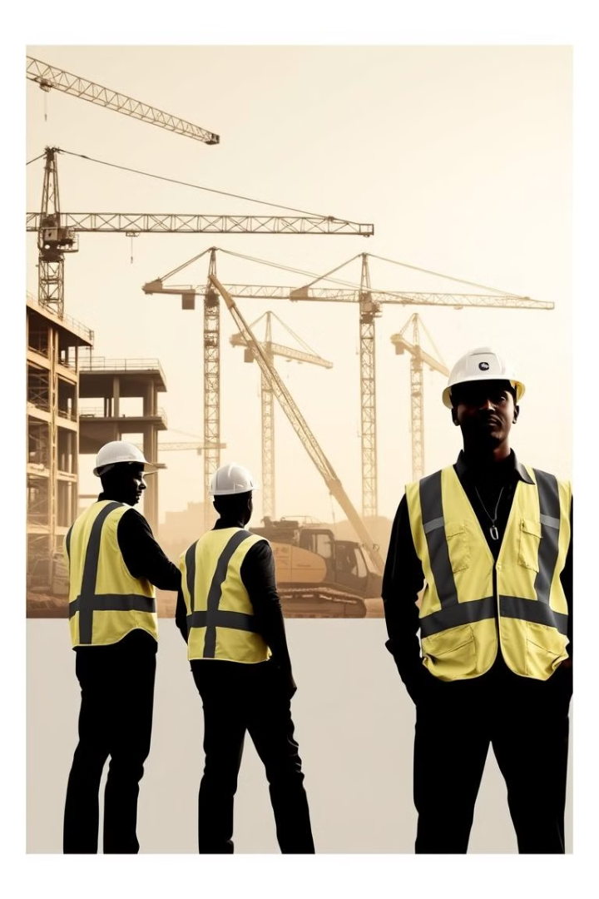
MJENGO PLUG
Team
Christopher Mwangi
2. Silvia Nkanata
3. Esther Francis
INNOVATORS HUB

Slide 2
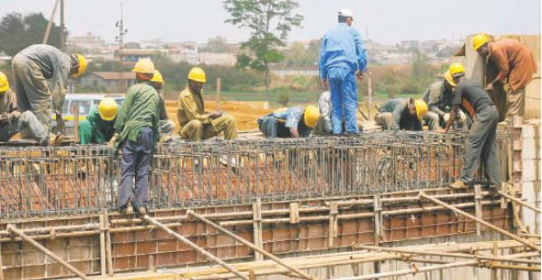
BACKGROUND
The Kenyan construction industry has seen a significant boom in recent years, driven by rapid urbanization, an expanding middle class, and increased demand for residential and commercial properties. However, this growth comes with its own set of challenges.
One of the major obstacles faced by contractors, property developers, and homeowners is the inefficiency in sourcing construction materials and finding qualified professionals, such as engineers and interior designers, to complete projects. While various suppliers exist, the process of sourcing quality materials, hiring skilled engineers, and finding expert designers often requires navigating multiple platforms, suppliers, and service providers, creating inefficiencies and delays. The absence of a centralized platform where users can access these services in a seamless manner contributes to an increase in project timelines and costs..

Slide 3
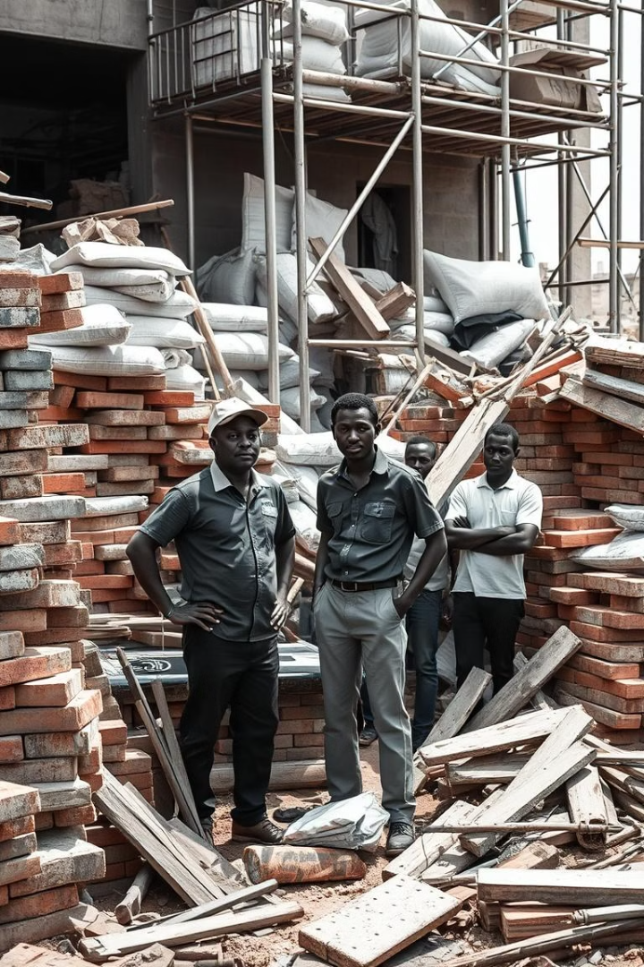
Statement Problem
The construction industry in Kenya is fragmented, with limited access to reliable, centralized platforms for sourcing quality materials, hiring engineers, and finding interior design solutions. Despite the rapid growth in construction, the absence of an efficient, all-encompassing digital marketplace contributes to significant delays, cost overruns, substandard work, and mismanagement of projects.

Slide 4
The Solution
Digital Marketplace
Streamlined Workflows
Data-Driven Insights
A centralized platform that connects construction professionals with verified suppliers and service providers.
Integrated tools for material and service procurement, supplier vetting, and project management.
AI-powered recommendations and analytics to optimize decision-making and cost savings.

Slide 5
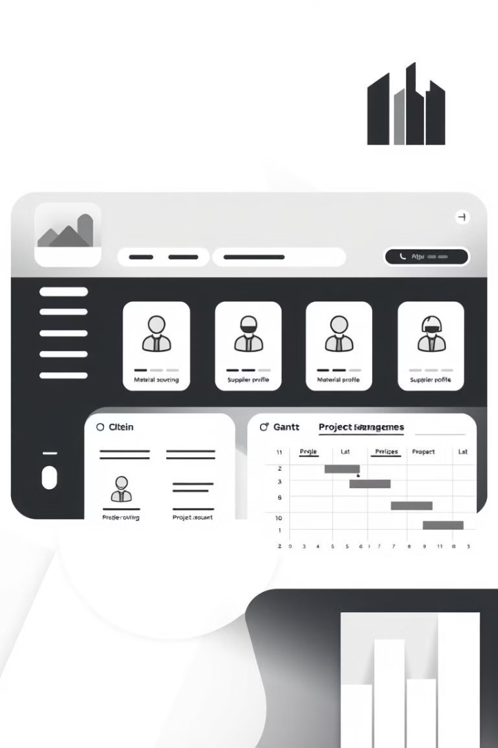
Minimum Viable Product (MVP)
Material Procurement
Service Providers
Centralized marketplace for construction materials and supplies.
Curated directory of verified contractors, consultants, and service vendors.
Project Management
Supplier Vetting
Tools for budgeting, scheduling, and tracking project progress.
Comprehensive evaluation and rating system for suppliers and service providers.

Slide 6

Challenges
1
Adoption Barriers
Adapting to digital workflows and embracing new technologies.
2
Building Trust
Establishing credibility and trust in the digital platform.
3
Data Privacy
Ensuring the security and privacy of sensitive information.

Slide 7
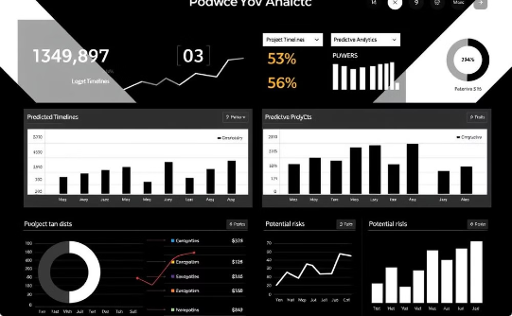

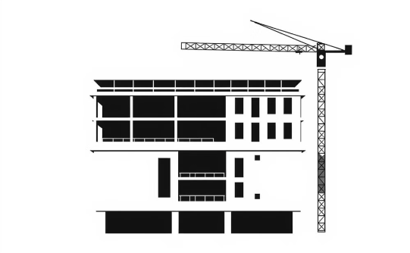
Future Plans
Predictive Analytics
IoT-Enabled Monitoring
AR/VR Visualization
Leveraging machine learning to forecast project timelines, costs, and resource requirements.
Real-time tracking and optimization of site operations of the hired services using Internet of Things (IoT) technologies.
Immersive tools for project planning, design review, and site coordination.

Slide 8
DEMO
Live Link…

